Slide 1
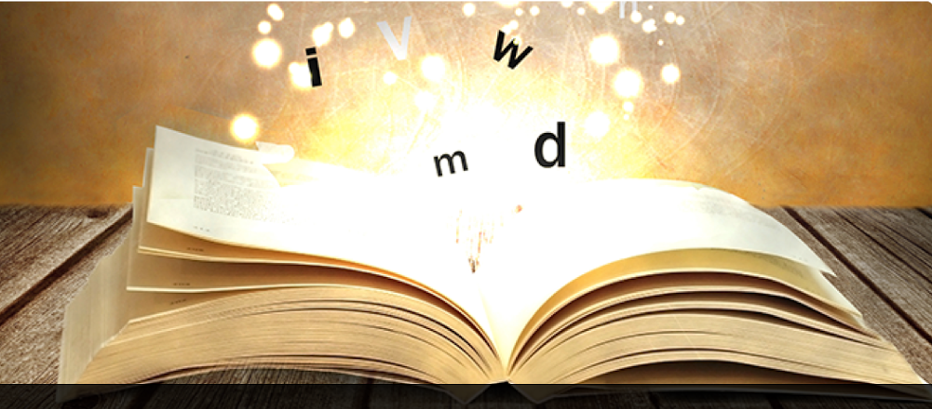


Tell Your Story
Using Storytelling to Share Project Successes
TAACCCT @ INNOVATE 2017
Notes:
Welcome to the Session on Storytelling and an introduction to a tool we think may help you and your project teams tell the story of your impacts and successes and yes even challenges in a way that is more engaging, more interesting, so that the knowledge gets shared and retold in the best of storytelling traditions. I am not a natural storyteller. Like my colleagues in this IMPACT community, I needed guidance and a tool help self-assess and take action. You should have picked up one of the tools (rubric) we are going to focus on for the next 45 minutes and at our workshop tomorrow at 9:45am.

Slide 2
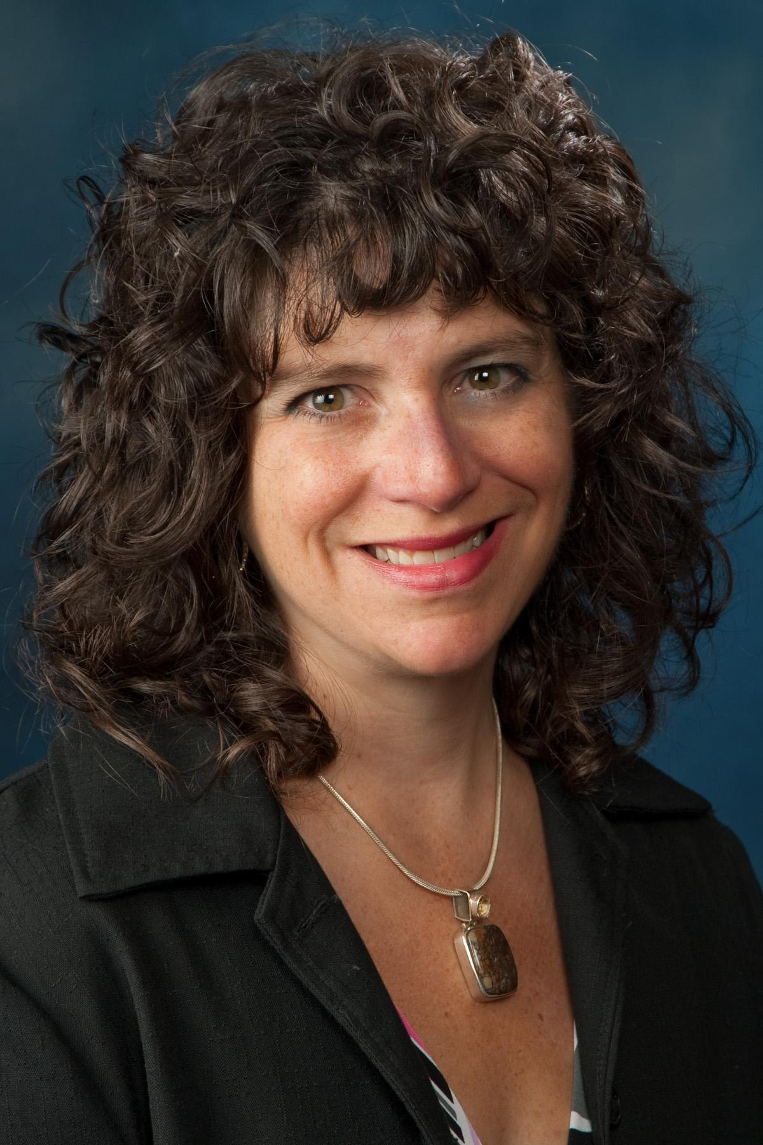

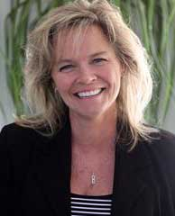

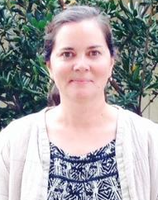




Who We Are
Helene Mancuso
Project Manager
TAACCCT Grant
Kathy Spada
Project Manager
INTERFACE Consortium
Maria Fieth
Program Manager, Communications & Community
Skills Commons
Nanticoke, PA
Wausau, WI
Long Beach, CA
Alexandra Shinert
Communications/Program Assistant
Northeast Resiliency Consortium
Nicolette van der Lee
Program Coordinator
Office of Continuing Education & Training
Paterson, NJ
Kahului, HI
Notes:
At INNOVATE 2016 five of us found our way to the TAACCCT strand focused on building IMPACT communities sponsored by skillscommons. We quickly realized we were interested in exploring ways to share our existing knowledge and innovate and solve problems and of course add to the skillscommons collection. This has evolved into the Storytelling Network now hosted on skillscommmons.
Since that time we have met virtually to think more about our stories and the tools that can be used to tell them in ways that are more authentic and engaging. We are all learning about the process because we believe this is important work so that our TAACCCT innovations will live on. We are interested in how we can move away from traditional kinds of reporting and through stories, scale transformative change. Stories can provide guidance, share wisdom and solutions to common problems and those solutions get passed down with each story.

Slide 3
Excuses
I don’t think about it
I tend to ramble and lose the point
I have a hard time gauging interest
I am never sure how much detail to use
I don’t have time
I don’t have good stories to share
I am too busy writing reports
I will look really silly to my colleagues
We don’t have a storytelling culture at my college
Notes:
Reasons we can’t do this. We all have a little story going on in our heads. Perhaps this intra-conflict sounds a bit like this.
SKIT: Kathy to audience: At your organization, at the very mention of storytelling you may get a reaction like this.
SCENE:
Kathy: Did you hear that Cheryl Martin at DOL wants us to submit stories to the TAACCCT mailbox? I don’t get it. APR, QNPR 9130, leverage reports, what else do those TAACCCT people at DOL want from us? Storytelling, who has time for that and who cares. I can just hear my board of directors when I tell them I spent the day writing a story!
NV:
Stories are a powerful way to reach people as we retain stories far longer than data, and have evolved to listen and learn from them. Stories underpin cultures of companies, organizations, and entire countries. New people learn what to do and how to assimilate though hearing the stories of others.
The same can be said for anecdotes, which are basically short stories. A Stanford research study showed that statistics alone have a retention rate of 5-10%, but when coupled with anecdotes, the retention rate rises to 65-70%.
The reality is that many of us don’t bother with stories – not because we don’t think they are important – but because we’re not sure how to tell them well. Here are some of our tips for how to embrace the amazing storyteller that lies within all of us.
SCENE END

Slide 4


Story Building Blocks
An Effective Character
Trajectory
Authenticity
Action-Oriented Emotions
A “Hook”
Retrieved from:
csic.georgetown.edu/research/strategic-storytelling/stories-worth-telling/
Notes:
Our StoryTelling IMPACTCommunity researched best practices in storytelling. We discovered a framework for storytelling building blocks from the Center for Social Impact Communication at the School for Continuing Studies at Georgetown University, and the Meyer Foundation.

Slide 5
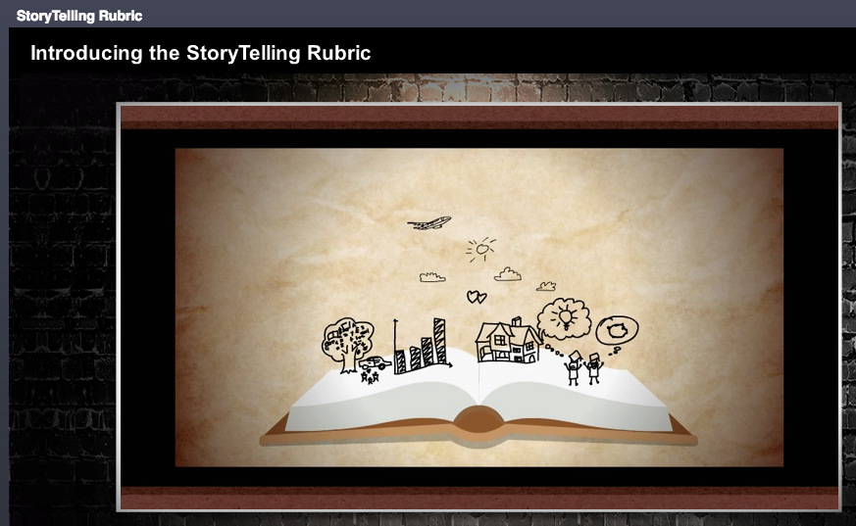
Introducing the StoryTelling Rubric
support.skillscommons.org/documentation/rubric/story_html5.html?lms=1/
Notes:
Inspired by the Story Building Blocks framework, we decided to develop a rubric to help us tell more effective stories and make our reporting efforts more engaging.
*To produce better stories that are strategic, compelling, inspiring, resonate, celebrate successes and challenges overcome.
Introduce a rubric today of building blocks that can help translate your desire to do this into action.
today we are going to walk you through the 6 building blocks
Tomorrow you will have an opportunity to practice and refine your storytelling skills.
http://support.skillscommons.org/documentation/rubric/story.html
Share the StoryTelling Interactive rubric created by Focus Eduvation, technology partners present today. Share the rubric.

Slide 6
Elements of Good Stories
Character
Plot
Voice
Resonates with the Audience
Emotions
A Hook
Notes:
Let’s take a look at the six elements of any good story. These are the fundamental building blocks you can use to develop your stories and self-assess them.
Character: Communicates Universal needs (emotions /intangibles) and connects with the audience.. This is a character who is relatable because of similarities of through connections (it could happen to me). Inspire self-reflection and action in the audience
Focus on a particular student’s journey or a particular programs development that in turn solved common, significant challenges and services. This component is about characters that are truthful and real and relevant.
Plot: Moves the story forward or backward or around. We had a Job fair and 43 employees and 125 students attended. This is not a plot.
The employers came to the IT job fair. The employers hired 25 students on the spot at the IT job fair. Now we have a plot. Questions pop into our head. Why did they hire them on the spot? What made them so attractive the employers? What can I replicate here?
Voice: Story resonates with the audience.
Shares a relatable perspective. Get the characters’ voice. We know how the character feels… We aren’t just telling them how to feel.
Engages audience in a natural, truthful and relevant way
Kathy:
NV:
Emotions: Engage the audience. Anger, frustrated, anxious, excited, awe. Persuade the audience to change their minds or behavior and to think about how to implement change in their own environment. Amuse, comfort, touch, stir, encourage.
A Hook: create an immediate and lasting connection with the audience. What’s at stake here> What is the urgency? If I miss this, what have I missed out on. I stayed in class and finished because of what my instructor told me……
Engagement: Give the audience a reason to stay engaged. Pull heart strings, Make them cry, underdog story, swim against the current, eat humble pie, incite commotion, make the contents about them.

Slide 7
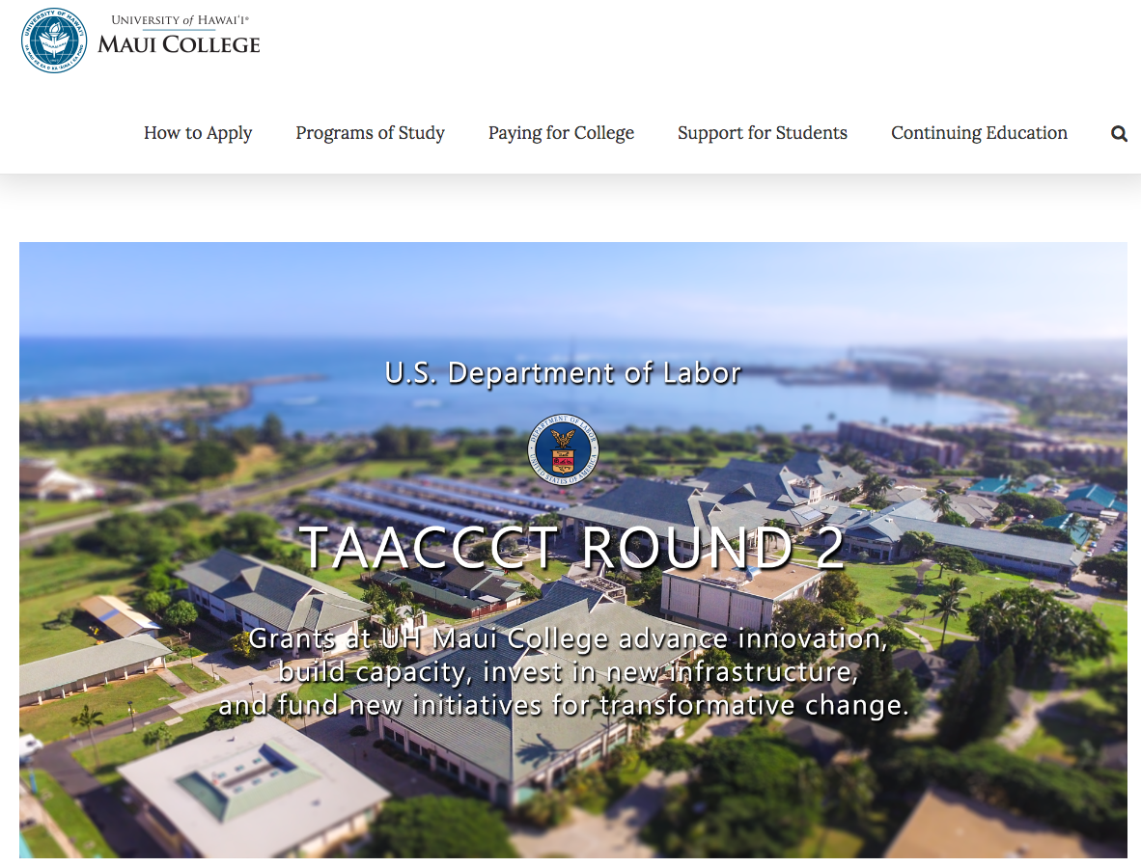
Talking Story in Hawaii
maui.hawaii.edu/grants
Notes:
In the TAACCCT Round 2 consortium grant in Hawaii, with UH Maui College as lead, we produced a grants website to showcase the success stories of our grant work, and leave behind resources for future grant initaitives to reference, and to support the sustainability of our grant projects.

Slide 8
GIS in Ecosystem Management Certificate
Notes:
One of our grant initiatives was an enhanced 8-credit GIS Certificate of Competence. The grant funded enabled an existing certificate to be condensed from 2 semesters to one semester with two 8-week back to back courses that essentially fast tracked the certificate. We also developed online modules for a flipped classroom approach where students could come to a lab class for hands-on learning using laptops funded by the grant to practice using the software, and take field trips to collect data and develop final projects.
The condensed format made it more attractive to incumbent workers who have busy schedules, and our credit students also loved the accelerated, hybrid course that gave them more lab time to ask questions and practice with instructor support. We achieved 82 certificate completions over the course of 2 years of the grant, engaged with over 130 employers, and had a 28% job placement rate.

Slide 9
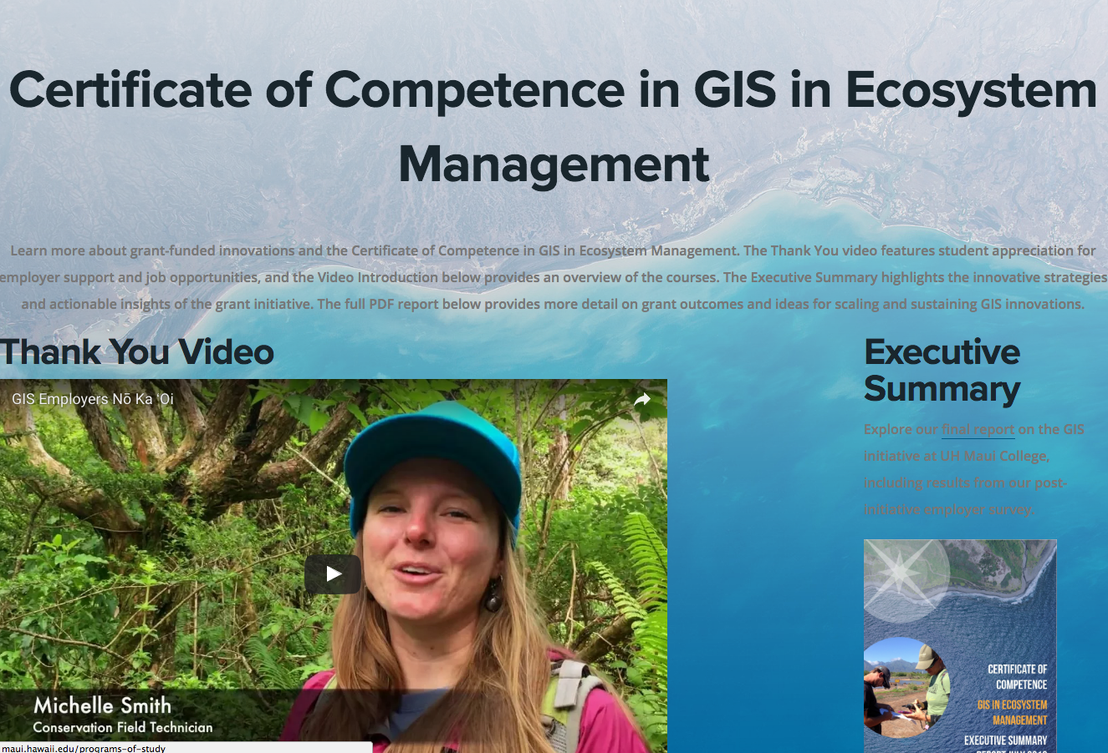
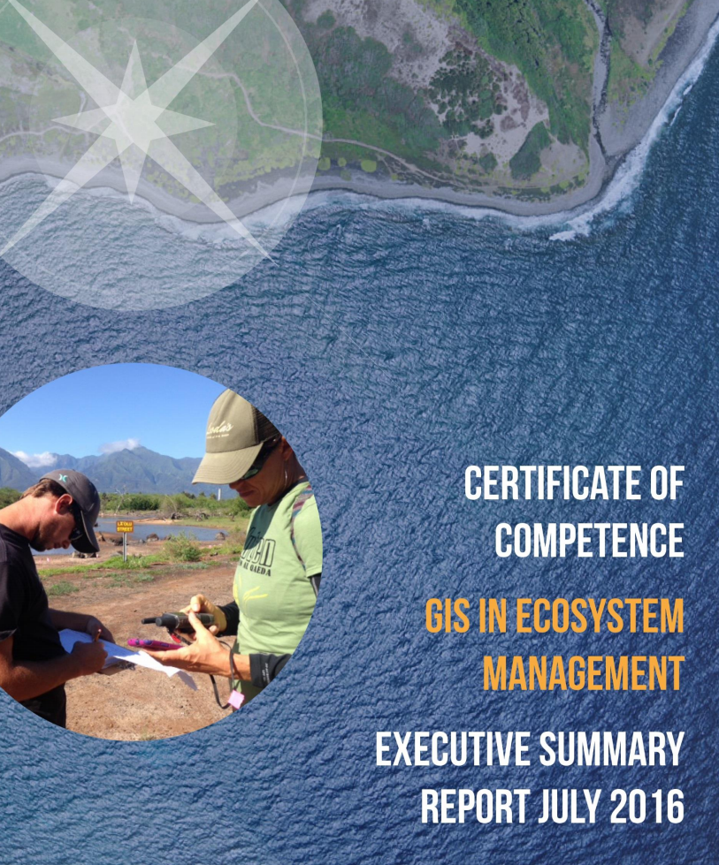

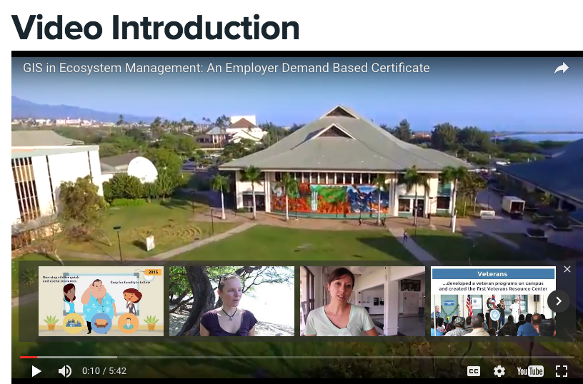
Creative Ways to Approach Reporting
PDF REPORTS
WEBSITE
maui.hawaii.edu/gis/report
eNEWSLETTER
VIDEO
Notes:
When it came time to do our reporting, we looked for lots of different creative ways to approach reporting using the storytelling rubric.
We created a website that features our storytelling success stories, we produced reports that used graphic design and storytelling techiques, we built a mailing list of over 200 contacts and sent out a quarterly enewsletter to stay engaged with employers and grant participants, and we also produced videos to use storytelling to share our successes.

Slide 10
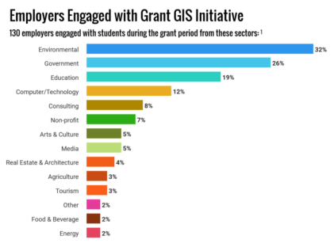

Success Stories to Support Sustainability
EMPLOYER ENGAGEMENT

Slide 11
Using the 2D StoryTelling Rubric
> Needs Improvement
> Acceptable
> Exemplary
Notes:
I’d like you all to refer to your 2D StoryTelling Rubric handout, and let’s go through an exercise of evaluating the video that we produced at UH Maui College to tell the story of the impact of our GIS certificate and thank our employers for supporting the program. The objective of the video was to express our appreciate to the employers who provided field-based projects, leave time to incumbent workers, and hired our graduates.
Referring to the 2D rubric, you can see that we have 3 different levels for each of the six categories: Needs Improvement, Acceptable, and Exemplary.
Our StoryTelling Network IMPACTCommunity developed this rubric to help us evaluate the stories we develop, and looks for ways to improve as we conceptualize and produce stories.

Slide 12
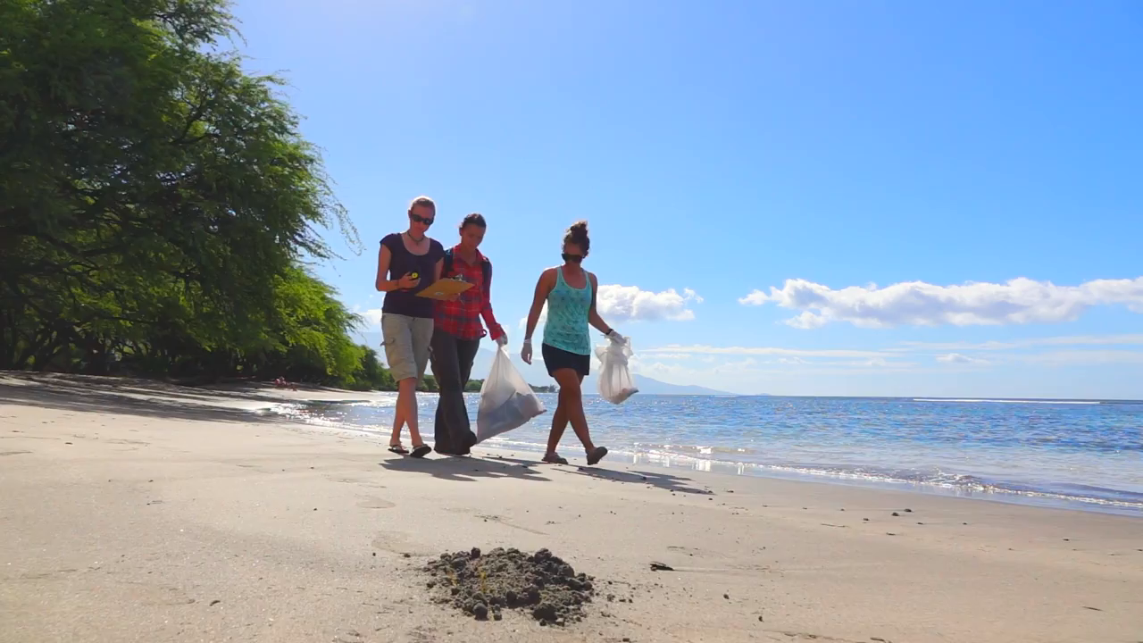
GIS Employers No Ka Oi Video
Notes:
Invite audience to evaluate the video and refer to the rubric.

Slide 13
Evaluation Using the Rubric
Character
Plot
Voice
Resonates with the Audience
Emotions
A Hook
Notes:
Invite audience to evaluate the GIS story using the key elements of the rubric.

Slide 14
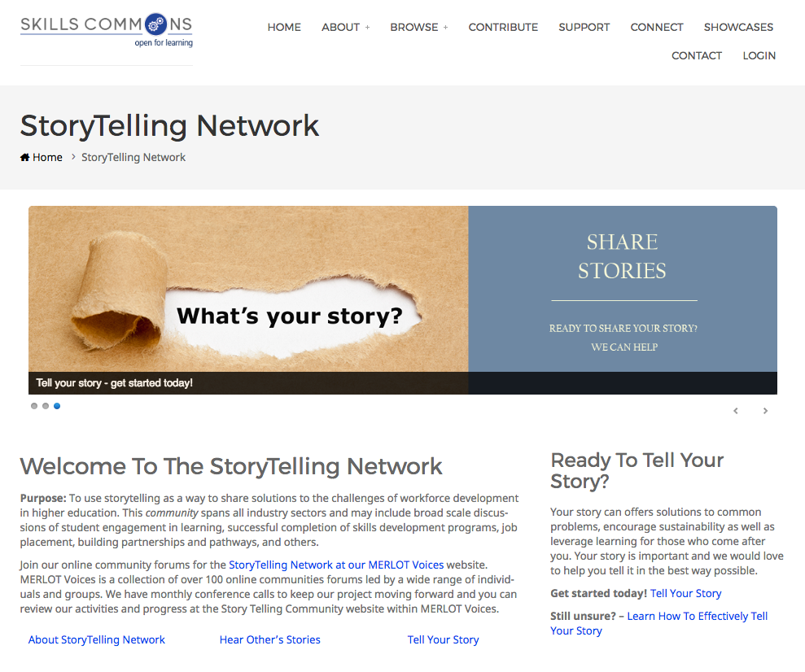
What’s Next?
http://support.skillscommons.org/connect/impact-communities/story-telling/
Notes:
Wrap up.
Highlight technology partners- FocusEduvation.
Step 6: Where we are at and where we see this going
Joined the StoryTelling Network IMPACT Community
Shared our existing knowledge with each other and built confidence
Turned our fear into fun through design and using evidence-based building blocks
Created an interactive rubric available at How to tell an effective story!
Created a proposal submission form
Now inviting you to submit your proposals to share your stories on grantee-led national webinars
Step 7: Use technology to makeover and complement or enhance your stories.
Consider a makeover for a story or presentation you have previously created
Attend a consulting session with a technology partner to discuss how they can help make your good work even better
Submit your proposal using the Tell Your Story Form
Reminder to all to use the technology partners in the room and to join us to practice using the rubric tomorrow 9:45-10:30am in the Gallery 1st floor.

